Slide 1
Predicting customer churn in Telecommunications Industry using Machine Learning
Presented by:
Mangaiyarkarasi Rathnakumar

Slide 2
Objective of this project
My goal is to predict the number of customers leaving phone service.
Customer churn is a major problem and one of the most important concerns for large companies. Because getting new customers is much more expensive than retaining existing ones.
Therefore, finding factors that increase customer churn is important to take necessary actions to reduce this churn.
Since it is churning customer(Yes) or not(No), this problem comes under classification.
This project is divided into 4 stages:
Data Cleaning and Exploratory Data Analysis.
ETL
Model Selection and hyperparameter Tuning.
Result Interpretation.

Slide 3
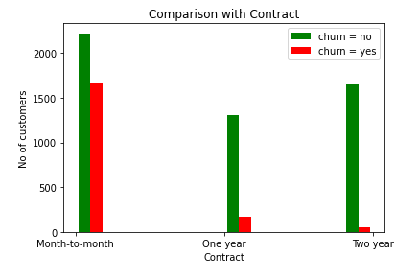
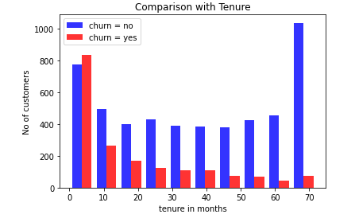
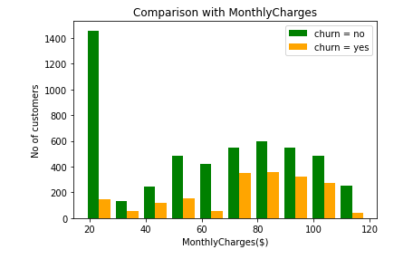
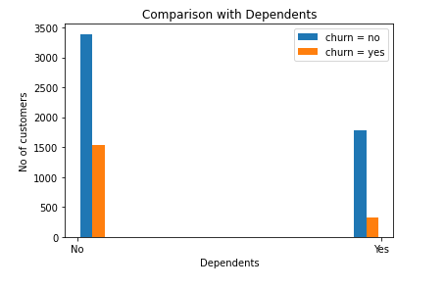
Exploratory Data Analysis(EDA)
Data Visualization will give quick insights of what is going on in data.

Slide 4
Observations from plot
From the plot, we can say that most of the churning customers are in month to month contract.
Customers who have been with the service less than 10 months are churning more.
Monthly Charges ranges from 70-100 dollars are one of the reason for more customers leaving. A customer with low monthly charges (<30) produce is much more likely to be retained.
If Customers and their dependents are using the service, they aren't churning more.

Slide 5
Recommendations to retain customers
By giving bundle offers like Dependents, Streaming TV shows, Internet.(All together but pay less)
By reducing monthly charges
By giving additional offer incentives, if they sign up for more than 1 Year contract. (To avoid quick churn).
Asking for feedback often from the customers
By Providing excellent customer service.

Slide 6
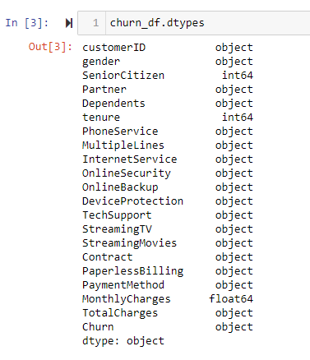
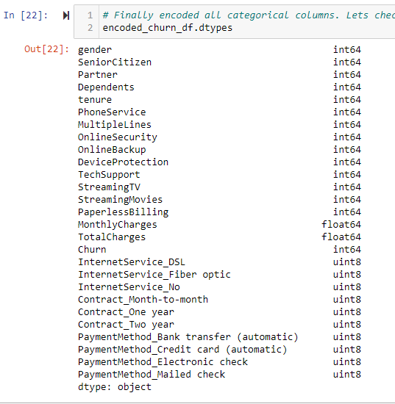
Preprocessing

Slide 7
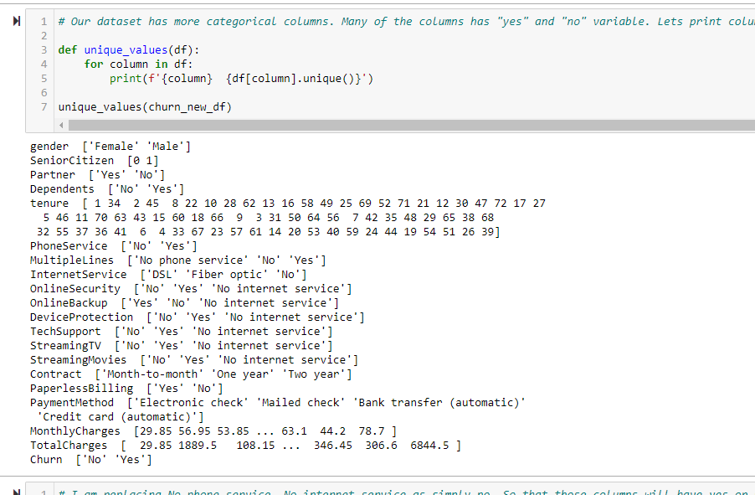
Encoding Categorical Features

Slide 8
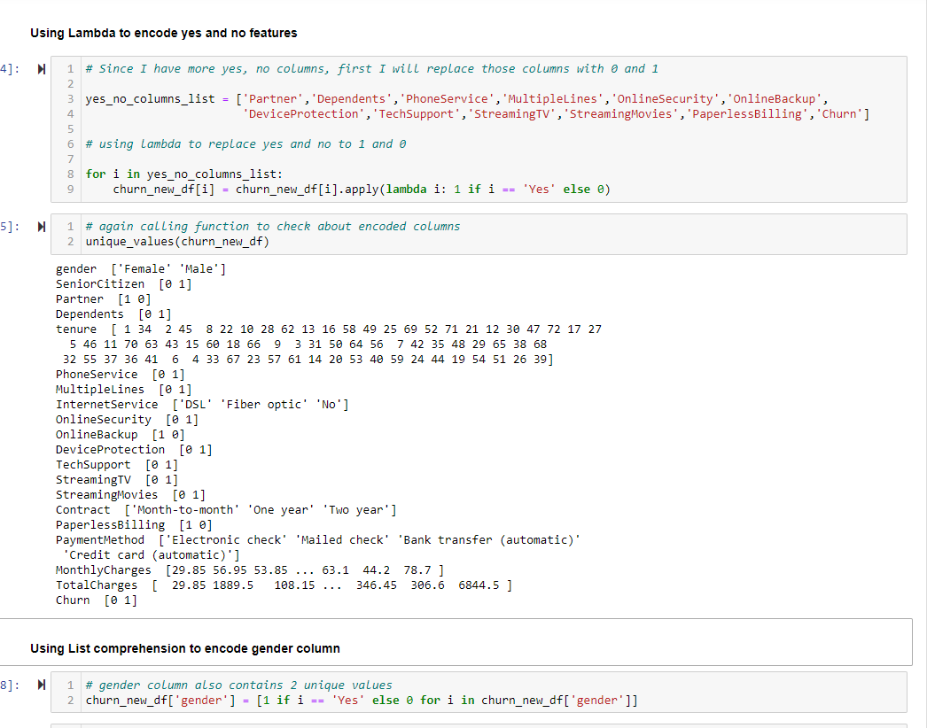
Encoding Categorical Features

Slide 9
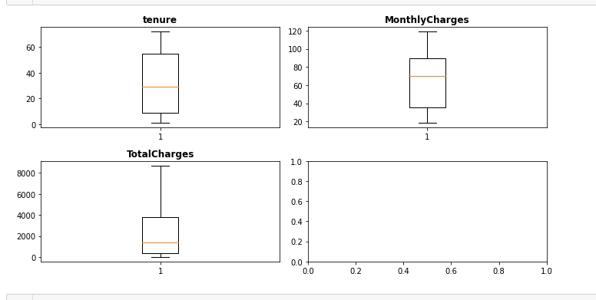
Checking for outliers
Summary about preprocessing steps:
There are no null values in this dataset.
Encoded 18 categorical columns
Standardization
Checked for outliers

Slide 10
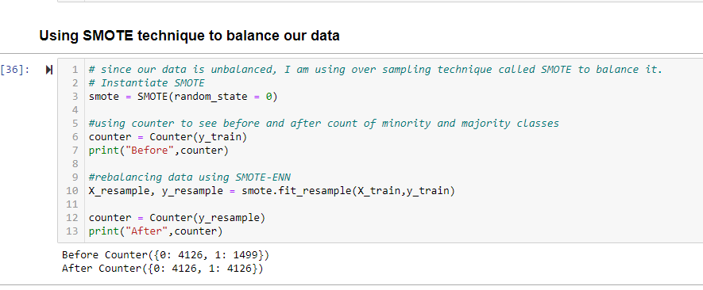
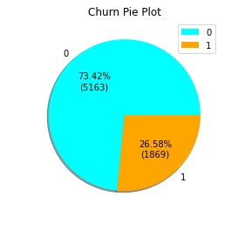
It is an Imbalanced Dataset

Slide 11
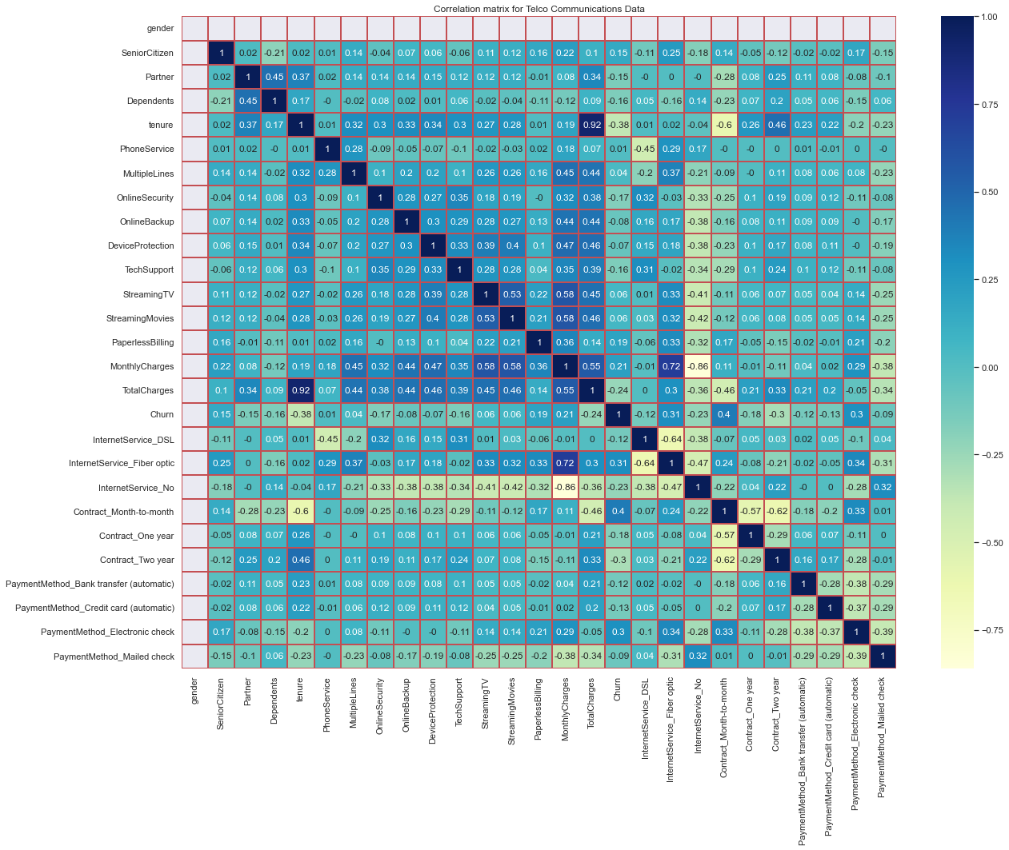
Heat Map

Slide 12
Discussions from Correlation Heat Map
The correlation goes from + 1 to - 1 where 1 is total positive linear correlation 0 is no linear correlation and negative 1 is total negative linear correlation.
From color bar,
Yellows are negative correlations,
Darker the yellow, stronger negative correlation
Middle section where the colors are real light blue where there's not much correlation at all
the Dark blues are positive correlation and
the darker the blue the stronger positive correlation
Churn is highly correlated(positive correlation)with tenure, Internet Service_Fiber optic, Contract_ Month-to-month, Contract_ Two year, Payment Method_ Electronic check.
Churn is strongly correlated with itself.

Slide 13
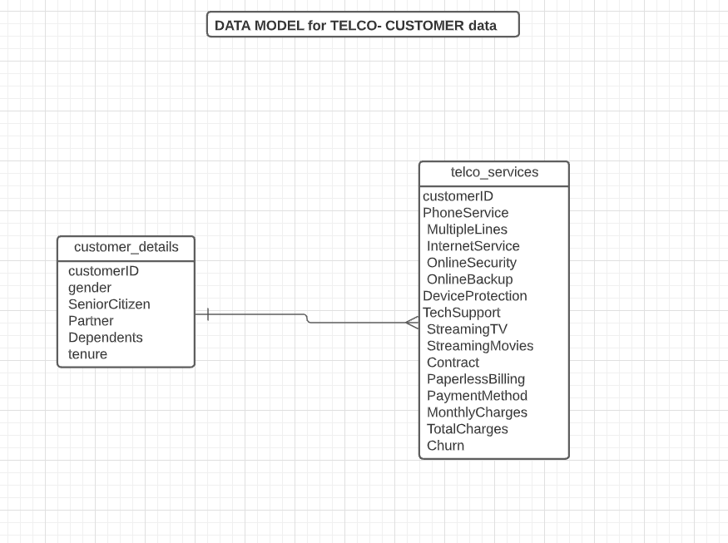

Slide 14
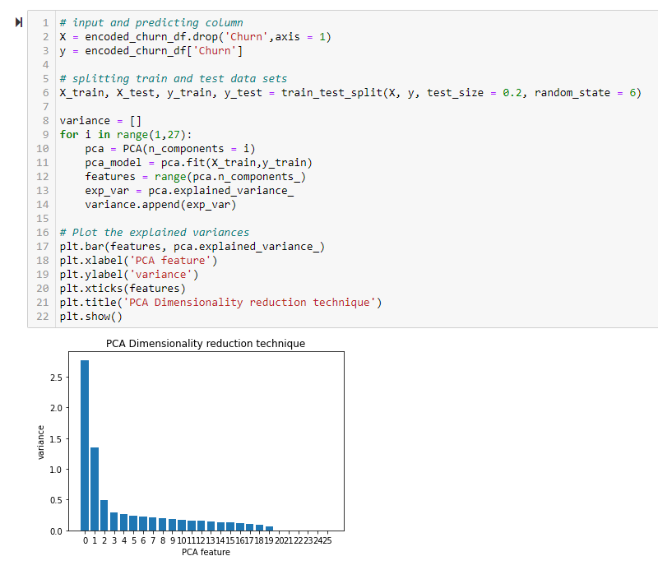
Dimensionality Reduction

Slide 15
Machine Learning Models I used:
Logistic Regression:
Logistic regression is a statistical analysis method to predict a binary outcome, such as yes or no, based on prior observations of a data set.
Since it predicts probability, the output values lies between 0 and 1(probability always lies between 0 to 1)
Support Vector Machines
Main Objective of Support Vector Machine is find a hyperplane for an N Dimensional features that classify the data points. Hyper planes are decision boundaries that help classify the data points.
Datas which on or near to the boundary (hyper plane) are called support vectors. Hence the name become Support Vector Machines. Hyper plane which contains maximum distance between support vectors is the best hyperplane we can select.
SVM has a special property it uses only the support vectors and the rest of the data points can be removed without affecting fitting the model. All Other classifiers uses all data points while fitting the model.

Slide 16
Random Forest Classifier (Bagging technique)​
Random Forest is a bagging(bootstrap aggregating) technique. Base estimator is decision tree. RF combines various decision trees to produce more generalized model. We can reduce high variance using bagging. Independent estimators​.
Each tree will split based on different features. Since it is a bagging technique, RF is a parallel process, meaning - doesn't wait for the previous process to be done.​
XG Boost Classifier (Boosting technique)​
It is a boosting technique. These techniques are sequential - processes are executed one after another. Dependent estimators. Boosting will attempts to correct the errors of previous model.

Slide 17
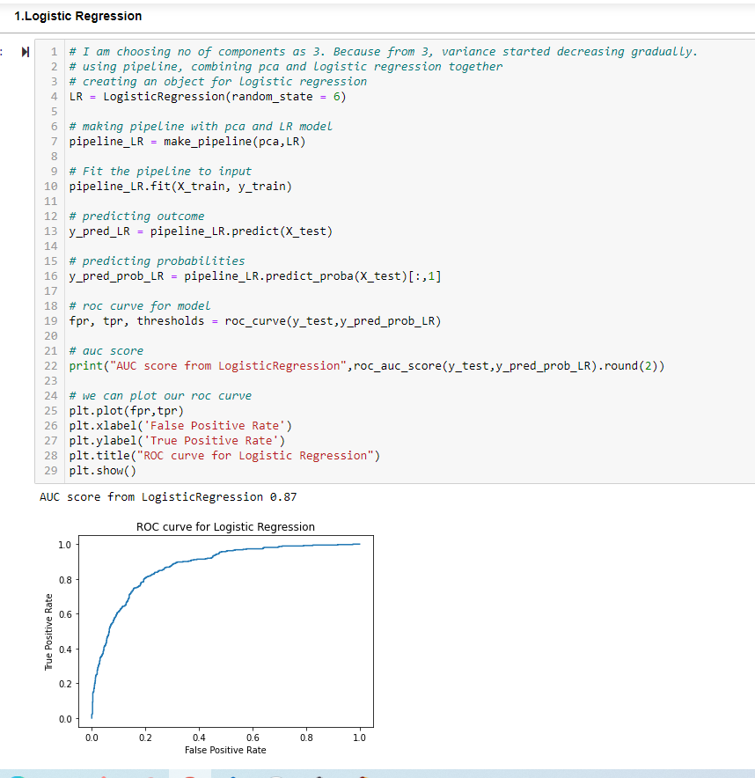

Slide 18
Hyper parameter tuning
* A parameter being manually set by modeler is called hyper parameter. To obtain best model performance we need to tune hyper parameters.
* Model's default hyperparameters are not optimal for all problems.

Slide 19
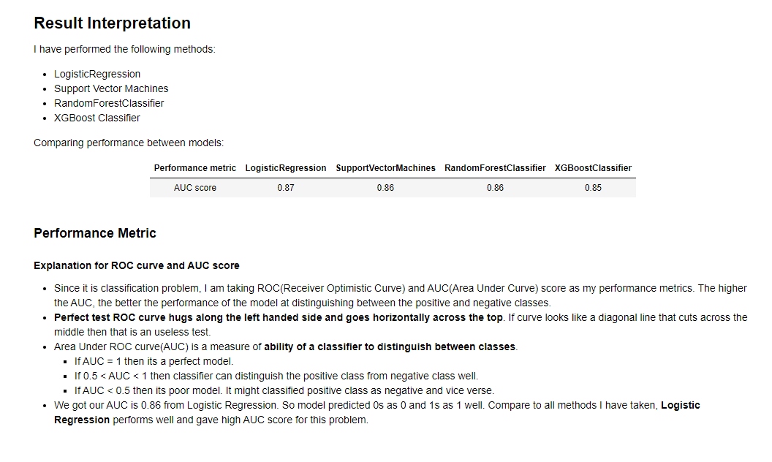

Slide 20
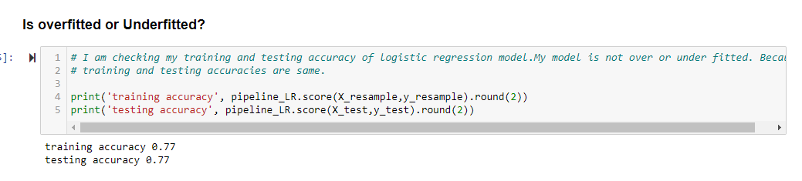

Slide 21
Conclusion
I have started by cleaning the telco customer churn data and analyzing it with visualization. Stored the data in a database and used ETL to get it there. Created a data model. Then, to be able to build a machine learning model, transformed the categorical data into numeric variables (feature engineering). After transforming the data, I tried 4 different machine learning algorithms using default parameters. And then, tuned the hyperparameters of those algorithms for model optimization, obtaining an AUC score of 87% from Logistic Regression Algorithm.

Slide 22
THANK YOU!!!

